Slide 1

SurePoint: Exploiting Ultra Wideband Flooding and Diversity to Provide Robust, High-Fidelity Indoor Localization
Electrical Engineering & Computer Science University of Michigan
Benjamin Kempke Pat Pannuto Bradford Campbell Prabal Dutta

Slide 2
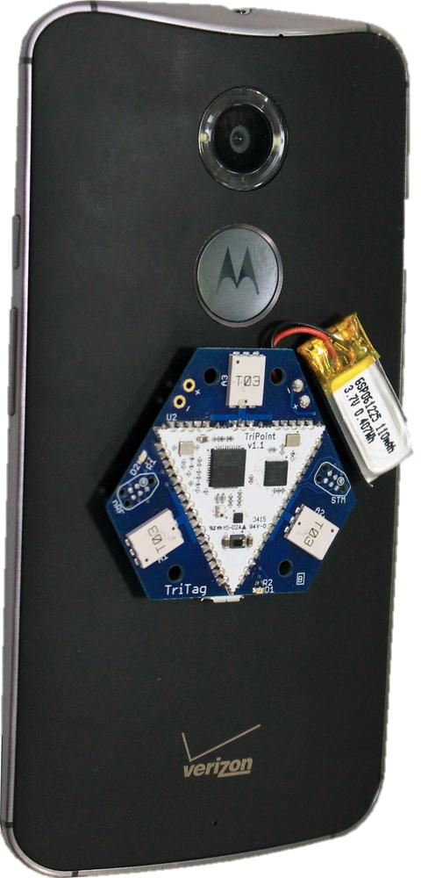
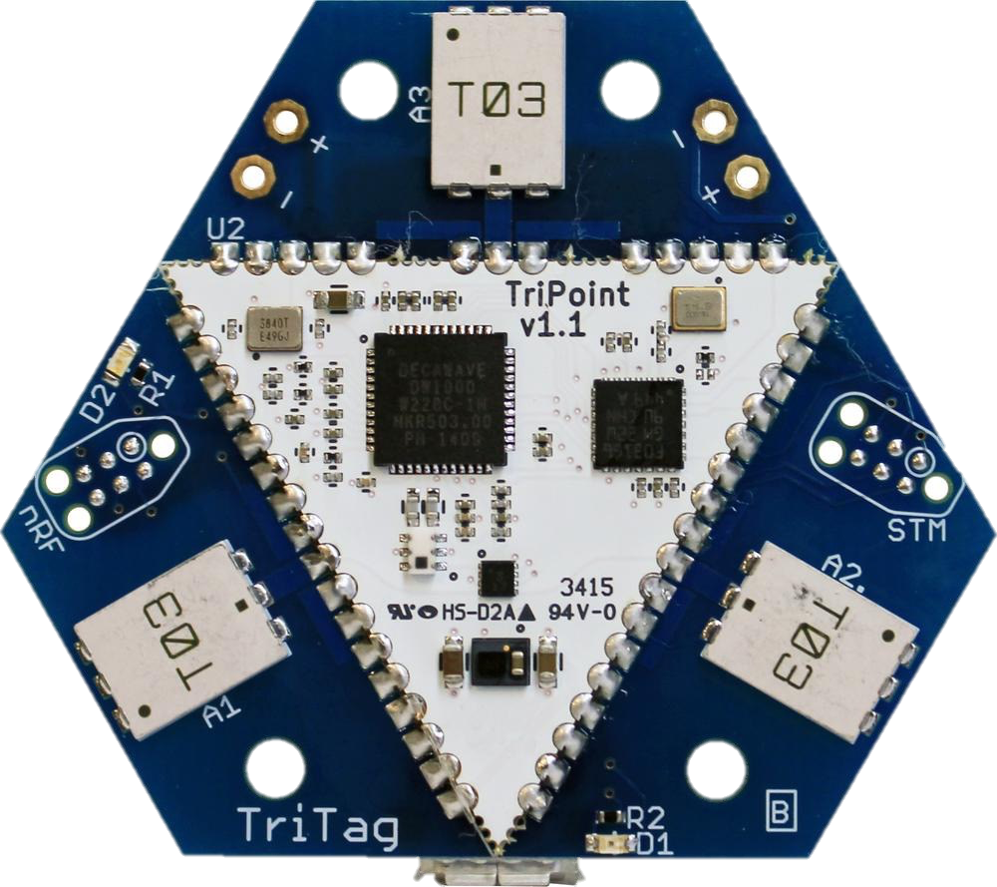
SurePoint: An Ultra-Wideband RF Localization System
SurePoint: a localization platform achieving high localization accuracy
50% within 17 cm, 95% within 76 cm
Enabled by commercially-available UWB
The Problem: Commodity UWB is a new technology with a number of limitations in its real-world implementation
Provide location abstraction, not a radio interface
?

Slide 3
Highly accurate (RF-based) indoor localization technology has arrived
10.00
Social fMRI [‘11/5.00]
RADAR[‘00/2.94]
Salathé [‘10/2.00]
LANDMARC [‘04/2.00]
WREN [‘13/2.00]
1.00
WASP [‘11/0.50]
Harmonia [‘14/0.40], RF-IDraw [‘14/0.38]
Accuracy (m)
PolyPoint [‘15/0.31]
Dolphin [‘04/0.24]
SurePoint [‘16/0.29]
0.10
Cricket [‘00/0.10]
Tagoram [‘14/0.12], WiTrack [‘14/0.12]
iBadge [‘02/0.10]
Harmonium [‘16/0.09]
Opo [‘14/0.05]
0.01
3D-LOCUS [‘09/<0.01]
1999
2002
2005
2008
2011
2014
2017
Time

Slide 4
Why Does Ultra-Wideband Yield Better Localization Performance?

Slide 5
Why Does Ultra-Wideband Yield Better Localization Performance?

Slide 6
UWB: A Performant Technology with Significant Limitations
Robustness
Regulatory-limited Transmit Power
Scalability
Modularity

Slide 7
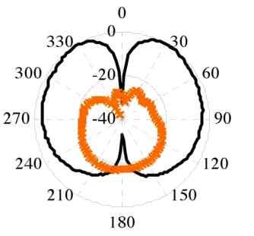
PolyPoint RF Localization System
X
X

Slide 8
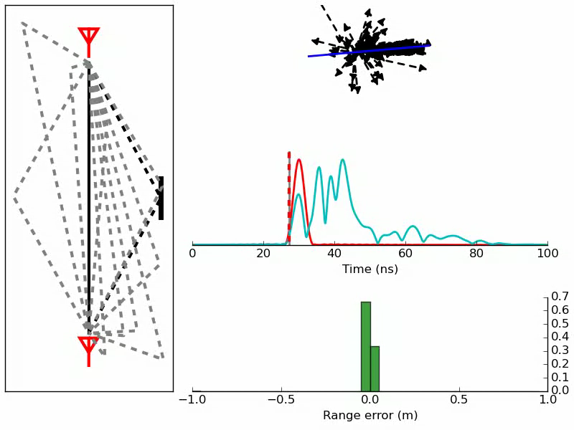
The Need for Diversity In the Presence of Line-of-Sight
802.15.4a Channel Model: Molisch, Andreas F., et al. "IEEE 802.15. 4a channel model-final report." IEEE P802 15.04 (2004): 0662.

Slide 9
The Need for Diversity Measurements
27 different observations of the RF channel
3 tag antennas * 3 anchor antennas * 3 RF channels
12th percentile of range estimates used
yields zero-mean distribution of error in LoS environments
Median ranging error:
17 cm to 8 cm
95th percentile ranging error:
65 cm to 34 cm

Slide 10
Ranging Error Stationarity
Range Error
?

Slide 11
Ranging Error Stationarity
Range Error
Range Error
?

Slide 12
Measuring Range Using Two-Way Time-of-Flight
time →
?

Slide 13
Efficiently Leveraging Diversity
M = # of measurements
time →
?

Slide 14
Efficiently Leveraging Diversity
N = # of anchors
M = # of measurements
?
time →
?
O(2*N*M) packets
Example: 2*4*27 = 216 packets → 5 Hz

Slide 15
Efficiently Leveraging Diversity
N = # of anchors
M = # of measurements
?
time →
?

Slide 16
Efficiently Leveraging Diversity
N = # of anchors
M = # of measurements
?
time →
?
O((N+1)*M) packets
Example: (4+1)*27 = 135 packets → 7 Hz

Slide 17
Efficiently Leveraging Diversity
N = # of anchors
M = # of measurements
?
time →
?
O(N+M) packets
Example: 4+27 = 31 packets → 32 Hz

Slide 18
UWB: A Performant Technology with Significant Limitations
SurePoint
Robustness
Regulatory-limited Transmit Power
Scalability
Antenna Diversity
Ultra-Wideband Flooding
Lightweight Scheduling & Synchronization

Slide 19
Addressing Scalability: Scheduling and Network Messaging with Glossy Floods
Adopted Low-Power Wireless Bus (LWB):
All data communicated using Glossy floods
Host schedules time slots for localization and flooding intervals
Incoming tags request to be scheduled during a ‘contention’ period
Outgoing tags either request to be unassigned or time out
Steady state operation: All tags scheduled with an even assignment of timeslots to tags

Slide 20
Adopting Glossy Concepts for Network Flooding and Time Synchronization
Glossy: Flooding with constructive narrowband interference
Allows for a robust means of broadcasting a single message to all nodes in the network
Narrowband
UWB
+

Slide 21
Extending Flooding to UWB: Multipath = Constructive Interference
0
1
2
3
4
5
+
0
1
2
3
4
5

Slide 22
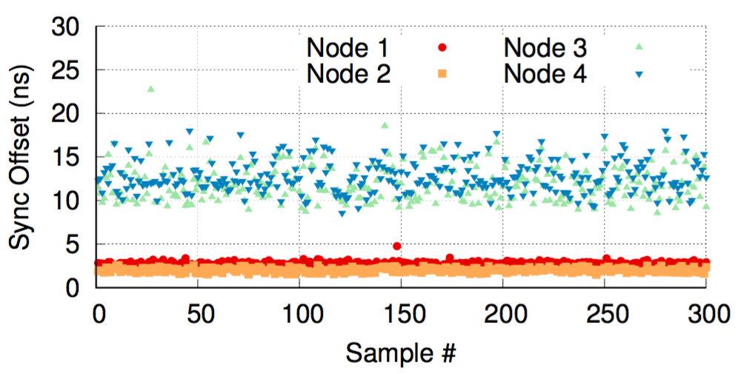
UWB Flooding Condition: Time Synchronization
X
0
1
2
3
4
5
0
1
2
3
4
5
Necessary condition:
Transmitter synchronization must be better than symbol time (preamble: 1 μs, data: 128 ns)
How it’s done:
Recurring flooding transmission times based on received flood timestamp

Slide 23
UWB Flooding Condition: Carrier Synchronization
0
1
2
3
4
5
0
1
2
3
4
5
Necessary condition:
Transmitter carriers must maintain coherence during flood packet transmission
How it’s done:
Crystal tuning continuously adapted based on inter-sync interval

Slide 24
UWB: A Performant Technology with Significant Limitations
SurePoint
Robustness
Regulatory-limited Transmit Power
Scalability
Modularity
Antenna Diversity
Ultra-Wideband Flooding
Lightweight Scheduling & Synchronization
TriPoint Module

Slide 25
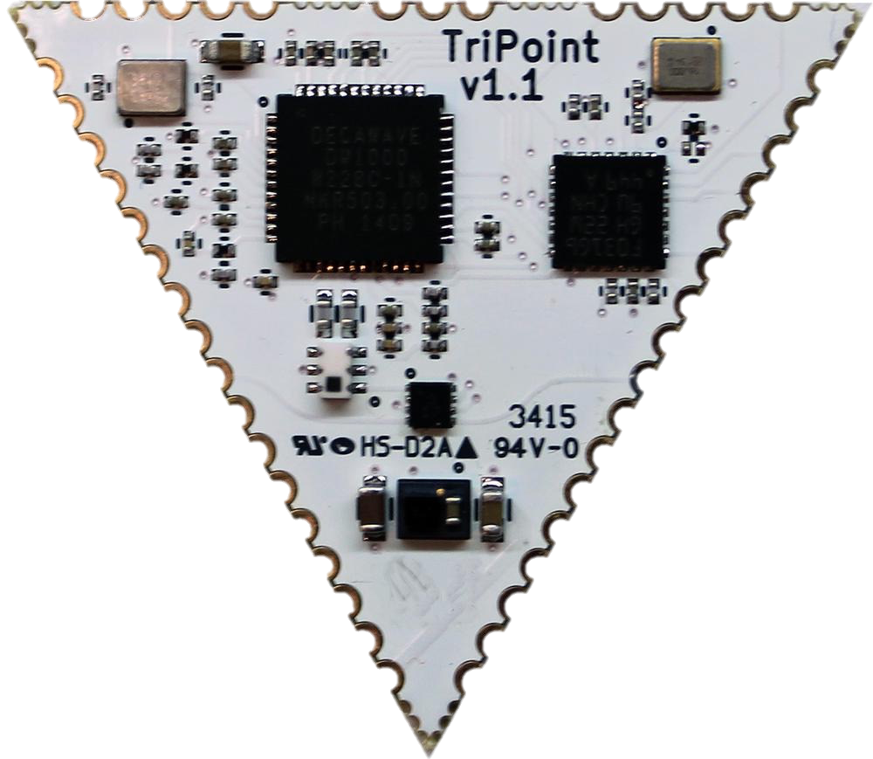
SurePoint’s TriPoint Module
Integrated module providing localization abstraction
I2C interface
STM32 MCU for protocol orchestration
DecaWave DW1000 UWB transceiver
Calculates ToAs of incoming packets
Triangular shape → Supports antenna diversity
Two-Way
Time-of-Flight
Time Difference of Arrival
?

Slide 26
Conclusion
Overcoming shortfalls of UWB localization to make deployable systems targeting a wide spectrum of potential applications
SurePoint:
Decimeter-level localization accuracy
Worst-case performance enhanced with diversity
Network-wide communication, scheduling, and synchronization
Scheduling with UWB flooding for reliable, network-wide communication
Localization abstraction, modular architecture to ease adoption
Performance to enable a variety of localization applications
17 cm median 3D error
95% within 76 cm
Ben Kempke

Slide 27
Questions?
Benjamin Kempke Pat Pannuto Bradford Campbell Prabal Dutta

Slide 28
Backup Slides

Slide 29
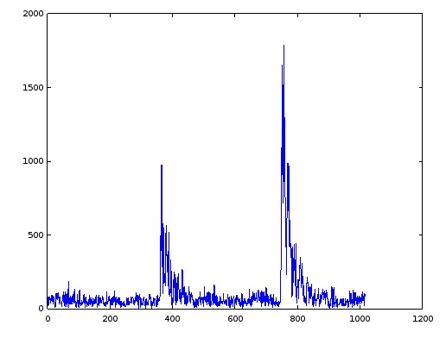
Extending Flooding to UWB: CIR Superposition = Constructive Interference
Intensity
Time (ns)

Slide 30
IPSN’15 Microsoft Indoor Localization Competition: A strong indicator of localization performance
http://research.microsoft.com/en-US/events/indoorloccompetition2015/2015_indoorloc_competition_light.pptx

Slide 31
And the best RF-based systems use Ultra-Wideband (UWB)
http://research.microsoft.com/en-US/events/indoorloccompetition2015/2015_indoorloc_competition_light.pptx

Slide 32
Efficiently Leveraging Diversity
N = # of anchors
M = # of measurements
O(2*N*M) packets
Example: 2*3*27 = 162 packets → 6 Hz

Slide 33
Efficiently Leveraging Diversity
N = # of anchors
M = # of measurements
O((N+1)*M) packets
Example: 4*27 = 108 packets → 9 Hz

Slide 34
Efficiently Leveraging Diversity
N = # of anchors
M = # of measurements
O(N + M) packets
Example: 3 + 27 = 30 packets → 33 Hz

Slide 35
Efficiently Leveraging Diversity
N = # of anchors
Minimum: 2*N packets

Slide 36
Efficiently Leveraging Diversity
N = # of anchors
Minimum: N+1 packets

Slide 37
Extending Flooding to UWB: Further Reach with Simultaneous Transmissions

Slide 38
Efficiently Leveraging Diversity
A total of 27 different combinations:
tag antenna (3)
anchor antenna (3)
UWB channels (3)
Full 2-way message exchange is too costly (27 * 4 * 2 = 216 packets)
Modified ranging protocol pares this down to a total of 34 required packets
27 broadcast one-way ranging packets
N (>4) unicast anchor → tag packets

Slide 39
Ultra-Wideband (UWB): The Burgeoning Choice for Indoor Localization
Time Domain
Frequency Domain
5.31 GHz
5.33 GHz
Narrowband
5 GHz
6 GHz
Ultra-Wideband

Slide 40
SurePoint Performance Assessment
17 cm median 3D error
95% of estimates within 76 cm
No noticeable degradation in the presence of fast tag movement (2.4 m/s)
<1 Watt active power

